Slide 1
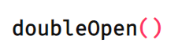
Double Open Workshops for Next-Generation Open Source Compliance
Report of the work package ‘Best for Validos Members’
26.5.2019
Jyrki Koskinen
Avaamo Konsultointi
Published under license CC-BY-4.0, © HH Partners, Attorneys-at-law Ltd.

Slide 2
Content
Introduction
Customer Analysis
Goal and Realization of the Customer’s Voice Workshops
Vaisala’s Workshop
Sandvik’s Workshop
Experiences, Conclusions and Next Steps
Appendix
Version management:
25.5.2019 Draft /Jyrki Koskinen, Avaamo Konsultointi
25.6.2019 Finalized and photos and videos added by Toni Päärni, HH-Partners, pending for approval
26.6.2019 Approved to be published with modifications by Jere Paavola, Sandvik AB
5.7.2019 Approved to be published with modifications by Petri Sairila, Vaisala Oyj
20.8.2019 Final modifications by Toni Päärni, HH-Partners, ready for publishing

Slide 3
Introduction
Objectives of open source license compliance activities are to: 1. Identify OSS licensed components and files; and the related licenses. 2. Comply with the obligations of such licenses. 3. Uncover any components/code snippets that may violate the OSS license terms and to take appropriate remedial actions.
The goal of the work package ‘Best for Validos Members’ was to
Understand the current state and pain points in compliance management within Validos members
Define a dream for next-generation OSS compliance and find solutions to implement it.
To accomplish the task two and three Voice-of-the-Customer workshops were planned to be arranged together with Validos members. At the end of the day, two workshops were organized, first one with Vaisala Oyj and the latter with Sandvik Ab. The results of the workshops create the basis for next-generation compliance solutions to be defined in the work package Double Open Compliance Concept and developed in work package Proof of Concept. The results of the workshops are published under license CC-BY-4.0
This document is a description of the work package Best for Validos Members. The document has been evaluated by Vaisala and Sandvik before publication.

Slide 4
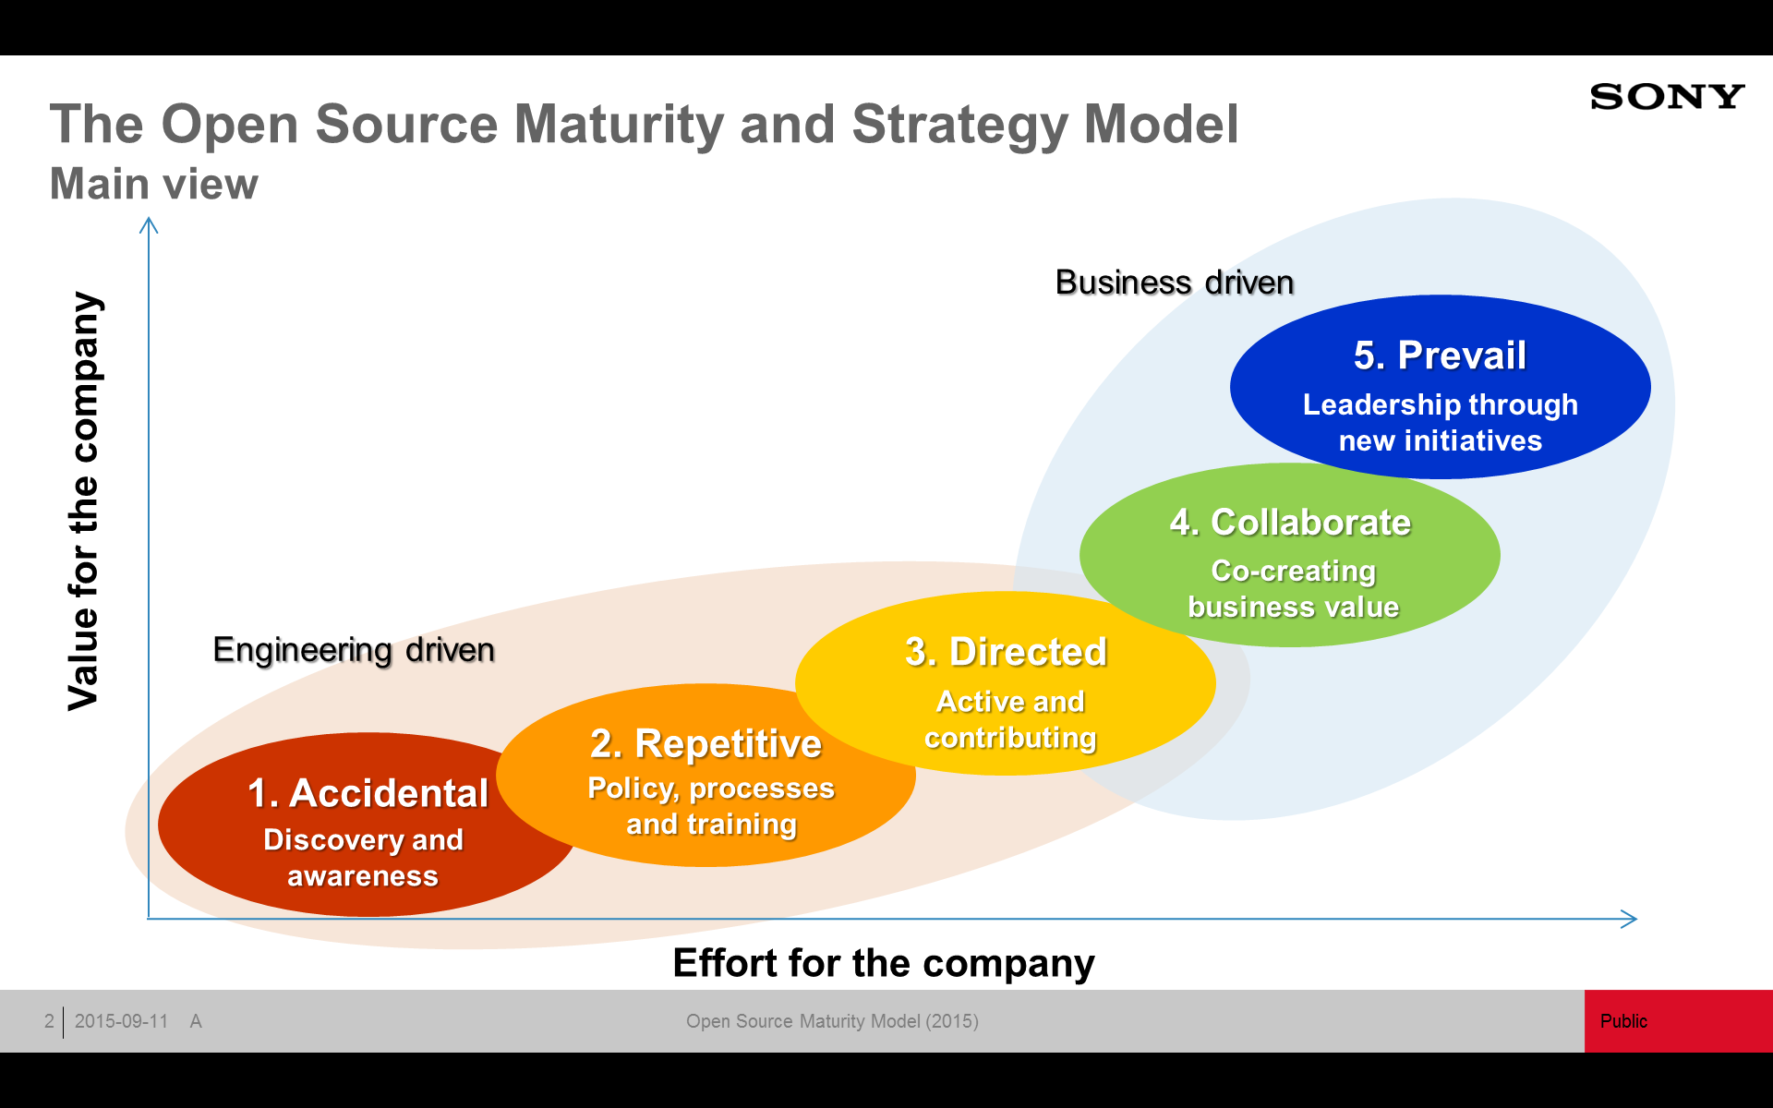
Customer Analysis
Open source maturity model originally created by Sony was used to give an insight into Validos companies and how they exploit open source software.
Validos companies fall currently mainly in two stages in the model, stage 2 and stage 3.

Slide 5
Goal of the Voice-of-the-Customer Workshops
The goal of the workshops was to:
Understand software development and its role as part of companies’ business
Get insight on how open source compliance is taken care as part of the software development and maintenance processes. What are the issues and pain points faced in compliance management?
Build a joint vision of the ‘compliance dream’ and create ideas on how to achieve the dream: renewed processes, new tools and methods, new competencies in place
Create rapport with the participants for future cooperation i.e. to make a joint Proof of Concept of the to-be-solution

Slide 6
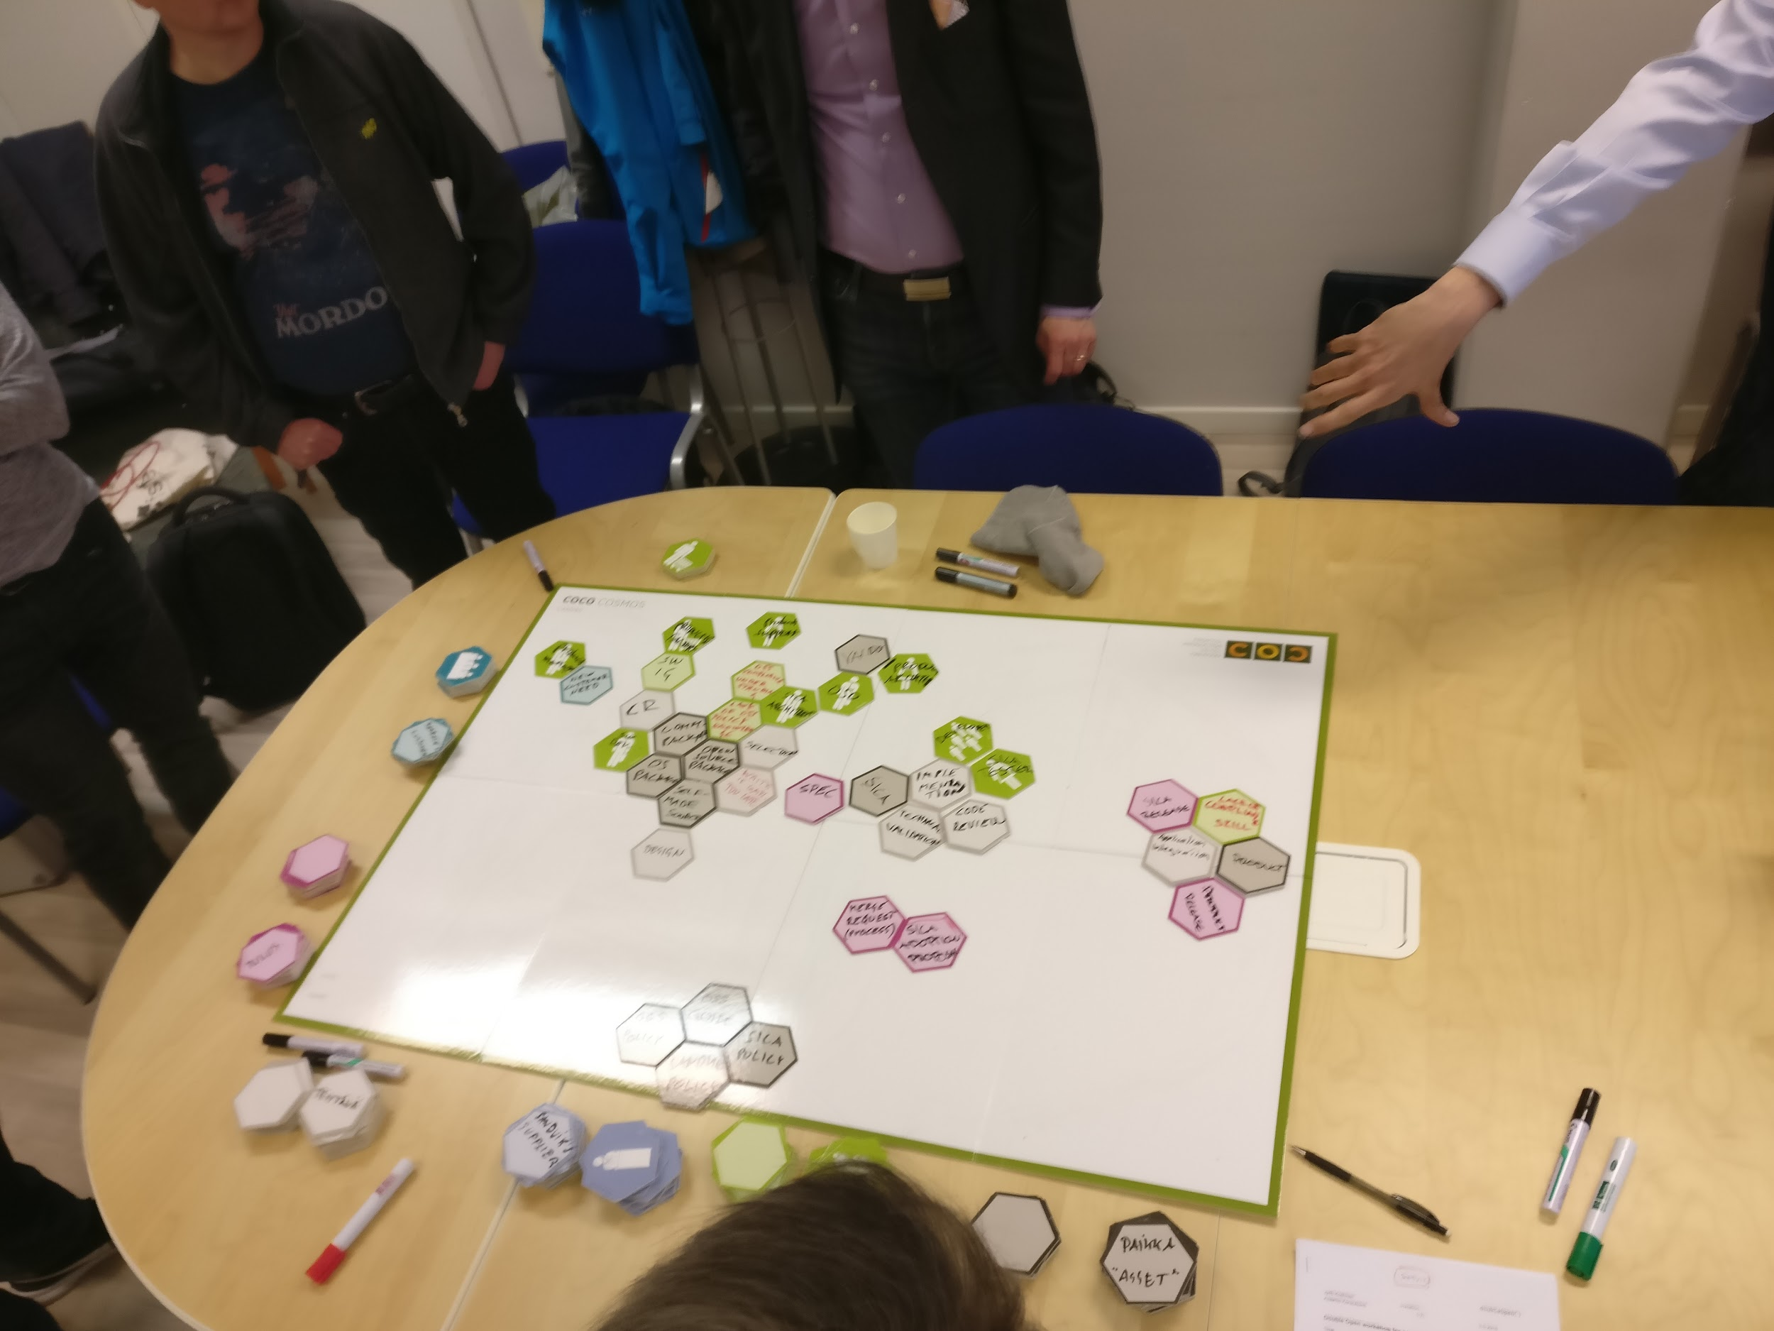
Realization of the Voice-of-the-Customer Workshops
Methods and Tools
The service design method used in the workshops was co-creation to capture everyone’s expertise and creativity. The tool was CoCo Cosmos, for communication and visual outcome.
The content of the workshop was divided into two phases: the current status with pain points and the dream and ideas for solutions. The result was documented by photos and videos.
See the agenda for the workshop in the appendix.
Case Sandvik, photo by Toni Päärni

Slide 7
Software Development Process & Open Source Compliance as Part of the Embedded Software Development Process
Systems engineering
- product
- software
Design
Implementation
Customer need
Requirements
Specifications
SW application
Compliance included
Compliance included
Compliance included
Source: Sandvik & development of embedded software

Slide 8
Vaisala Workshop 4.3.2019, Helsinki
People
Vaisala Oyj:
Petri Sairila, Development manager, compliance officer
Niko Mauno, Yocto, embedded Linux
Teppo Kankaanpää, Java/Javascript
Verifa Oy
Jacob Lärfors, subject matter expert
Kalle Soranko, subject matter expert
HH Partners Oy
Martin von Willebrand, subject matter expert, owner of Double Open project
Henri Tanskanen, subject matter expert
Toni Päärni, project manager of Double Open project
Avaamo Konsultointi
Jyrki Koskinen, fasilitator of the workshop
University of Helsinki
Tommi Mikkonen, project manager of 4API project

Slide 9
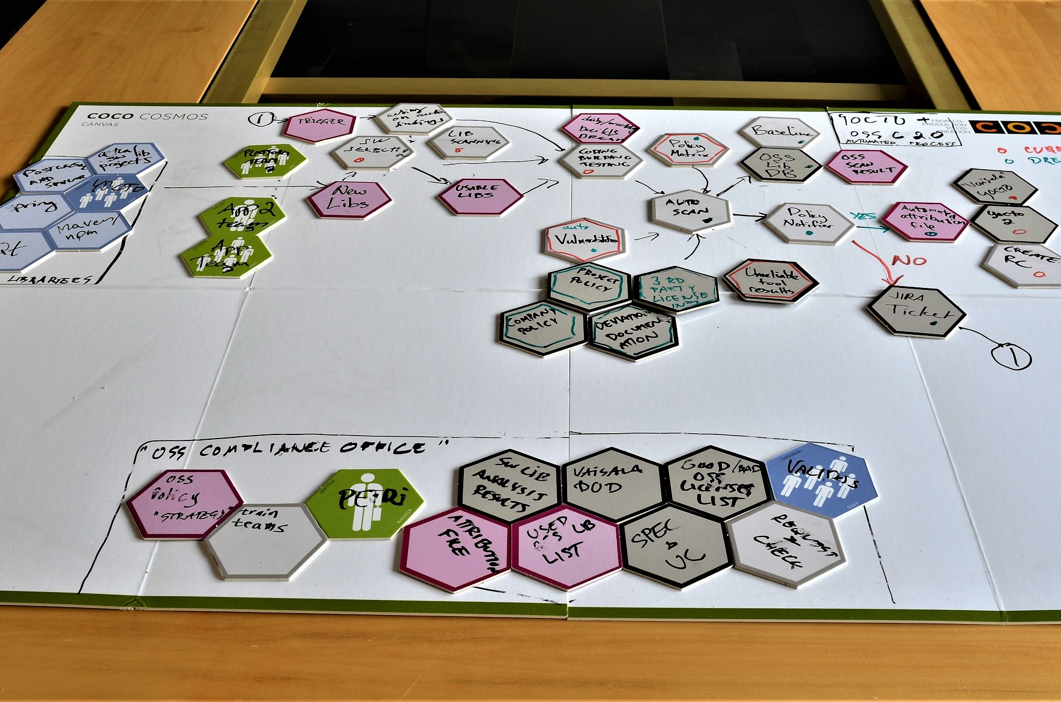
Vaisala Workshop 4.3.2019
Outcome:
A clear picture of current status and compliance pain points = laborious, error-prone and time-consuming
Dream for future and high-level components for the solution ‘OSS compliance 2.0’ (Yocto)
Verifa is eager to create the PoC of the toolchain and Vaisala is eager to contribute and exploit

Slide 10
Sandvik Workshop 7.5.2019, Tampere
People
Sandvik Ab:
Tuomo Hirsikangas, Engineering Manager, Surface Drilling
Veli-Pekka Jaakkola, Engineering Manager, Underground Drilling
Juha Keihäs, Lead Developer, Load & Haul Division
Johannes Koskinen, SICA architect
Jere Paavola, SW development manager, SICA platform, open source compliance officer
LifeLearn Oy:
Jussi Hurmola, expert in competence development & e-learning,
Fujitsu Oy
Marko Jaanu, subject matter expert
Avaamo Konsultointi
Jyrki Koskinen, fasilitator of the workshop
HH Partners Oy
Toni Päärni, project manager of Double Open project
Henri Tanskanen, subject matter expert
Martin von Willebrand, owner of Double Open project

Slide 11
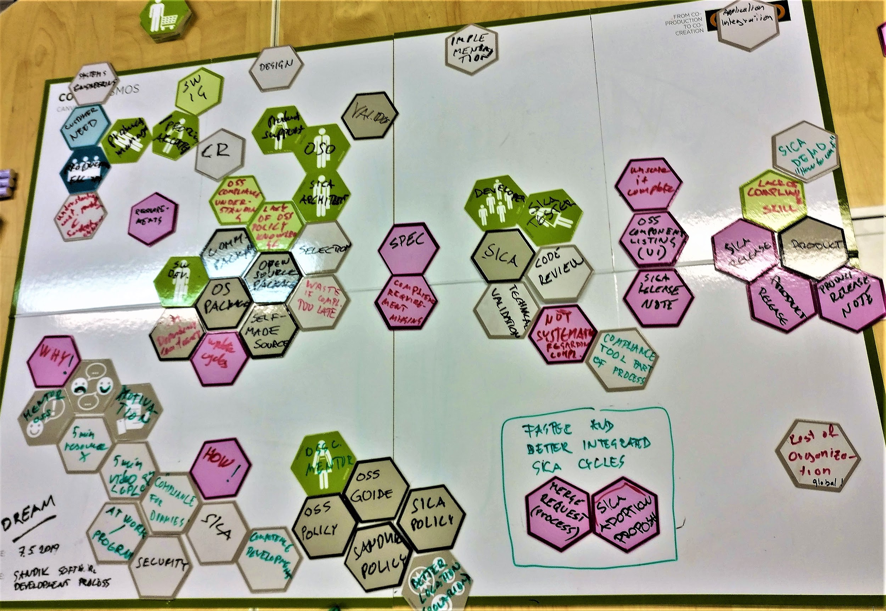
Sandvik Workshop 7.5.2019
Outcome:
A clear picture of current status and pain points = compliance practise is not fully adopted in the organization. Need to improve knowledge and motivation.
A dream for future and identification of ways how to update the organization’s competencies
Sandvik has already planned the first steps for education. LifeLearn is willing to contribute.

Slide 12
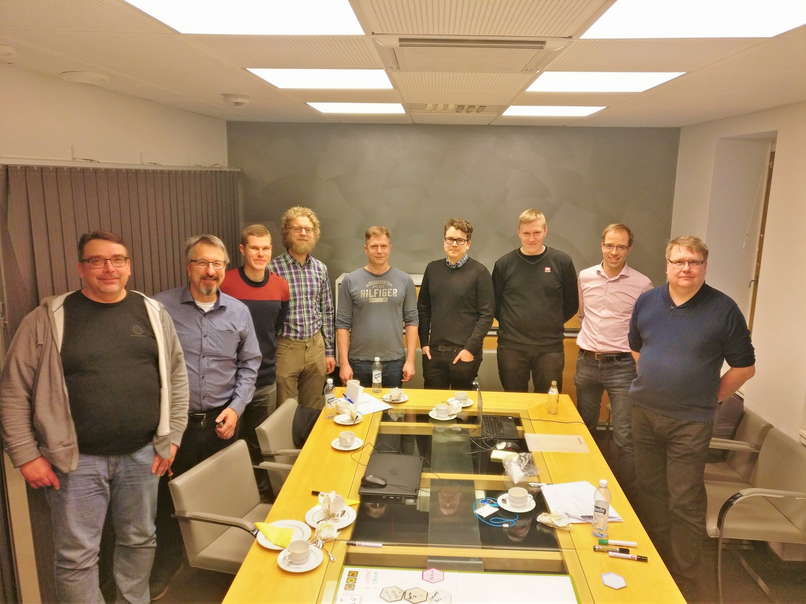
Experiences, Conclusions and Next Steps
Two different organizations were analyzed: Sandvik and Vaisala which can be placed in open source software compliance maturity level 2 (Repetitive) and level 3 (Directed)*
Two banks for solution for next-generation compliance management were identified: an automated tool and education service.
Vaisala and Verifa are willing to cooperate in the project to create an automated tool to improve efficiency in compliance management.
Sandvik is looking to cooperate in creation of a service for education and competence development to expand the motivation and proficiency within the organization. LifeLearn is a possible partner.
Team Vaisala, photo by Toni Päärni
* Source: Sony ‘Open Source Maturity and Strategy Model’, link

Slide 13
Experiences, Conclusions and Next Steps...
The workshop met the set goal giving insight into the current state and produced ideas for the solution for next-generation compliance management
The individual participants felt that the workshops met their expectations
The results of the workshops as part of work package Best For Validos Members were evaluated in the Steering Board meeting 16 May 2019. One of the point-of-views was if there is any need for further workshops to:
increase or strengthen our understanding or
gain ‘market share’, visibility and speakers within the community, which community?
The steering board decided that the current results give a decent basis for next steps and there is no need for further voice of the customer workshops.

Slide 14
Appendix
Sources
Results of the Workshops
Vaisala
Sandvik

Slide 15
Sources
Sony’s open source software maturity model, link
Github open source software maturity model, link

Slide 16
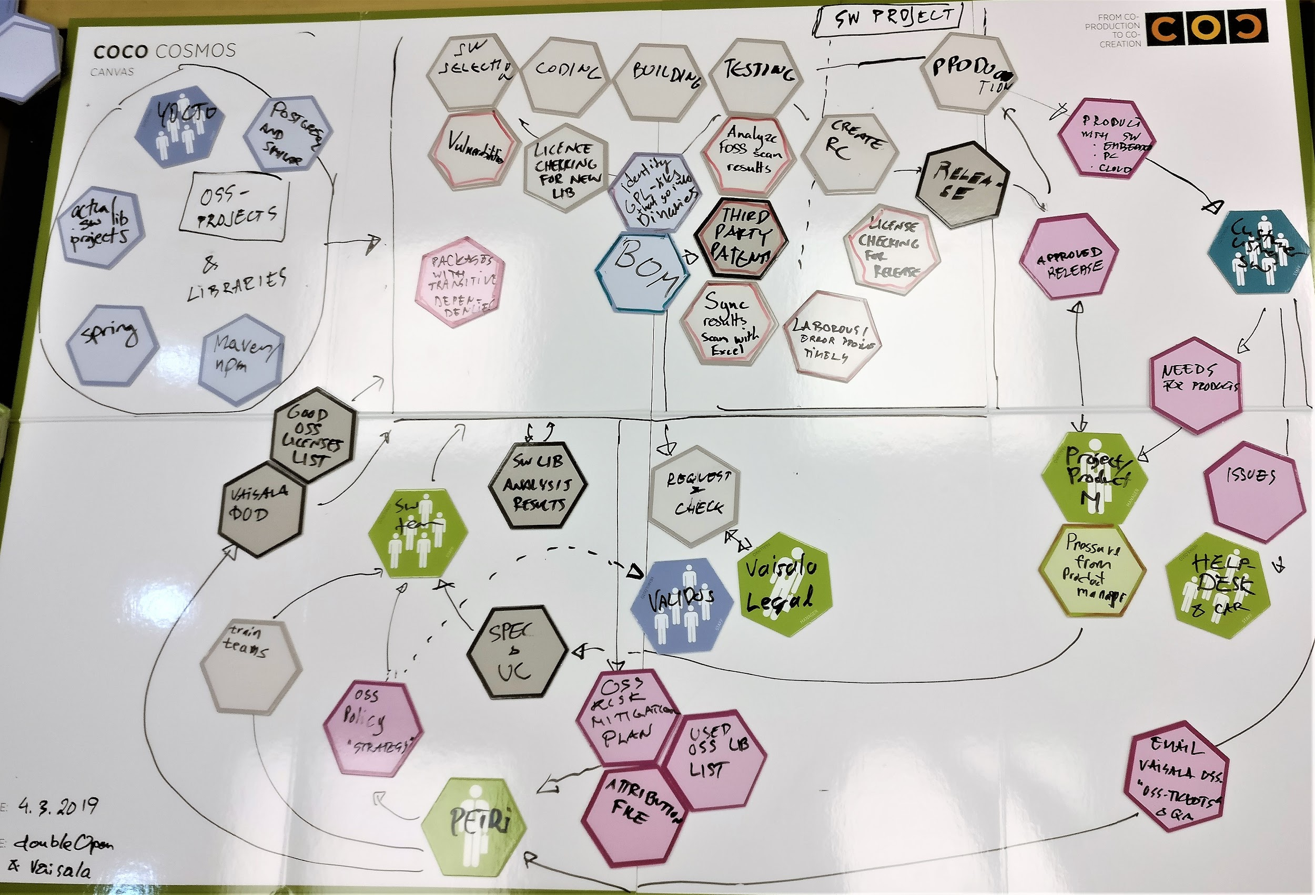
Documents of the Vaisala Workshop
Vaisala present
Vaisala dream
Photos by Toni Päärni & Martin von Willebrand

Slide 17
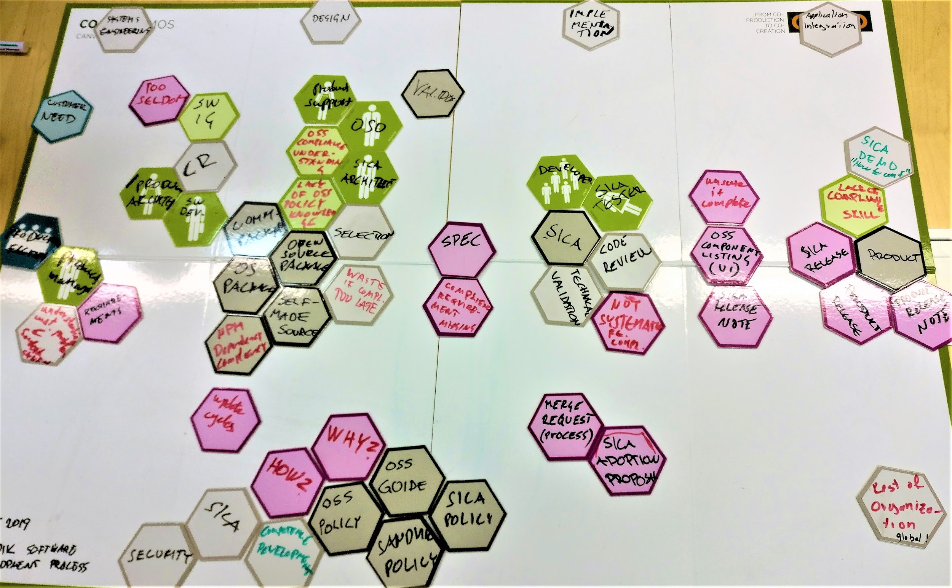
Documents of the Sandvik Workshop
Sandvik present
Sandvik dream
Photos by Toni Päärni & Martin von Willebrand

